Slide 1
FINDING LOGIC BUGS IN ANDROID APPLICATIONS

Slide 2
Whoami
Luke Symons - Rezk0n/R3zk0n
Offensive Security Engineer at SEEK
Mainly focusing on *OSX/Web and Mobile
Plays CTF's sometimes...not the past year...
Has some CVES. - CVE-2017-5900, CVE-2021-44511, CVE-2021-25504, CVE-2021-25499, CVE-2022-27838.. I do things.. but not really.

Slide 3


Agenda
Android Security Background
Revisit attack surface:
Activities
Intents
Content Providers
Case Study (CVE-2021-25499)
Intent Redirection on Galaxy Store Application
Case Study (CVE-2022-27838)
Improper access control leading to System Privileges
Date//Time//Year

Slide 4
Android Security Background
Android uses app isolation and sandboxing as a security mechanism unless the application is a system application
Every application has its own UID/GUID starting from UID 1000
However other applications must be able to talk to each other to issue commands.

Slide 5


Android has a custom Interprocess Communication (IPC) which is known as Binder which runs in kernel space
Intents and other Framework-level primitives such as:
Receivers
Broadcasts
Services
Are built upon the Binder Driver
Memory corruption bugs do exist on Android (BadBinder)
Memory protections such as NX/ASLR/DEP also do to...

Slide 6
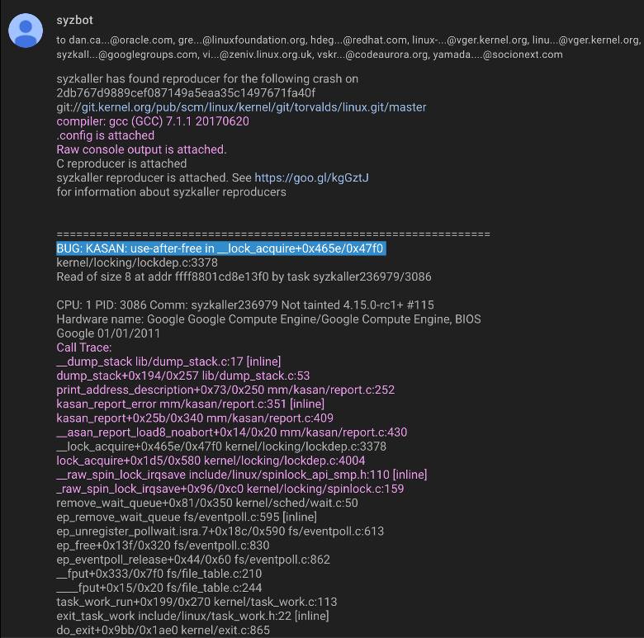
Android Kernel is fuzzed by Google via Syzbot, a syzkaller system that continuously fuzzes the Linux/Android kernel

Slide 7
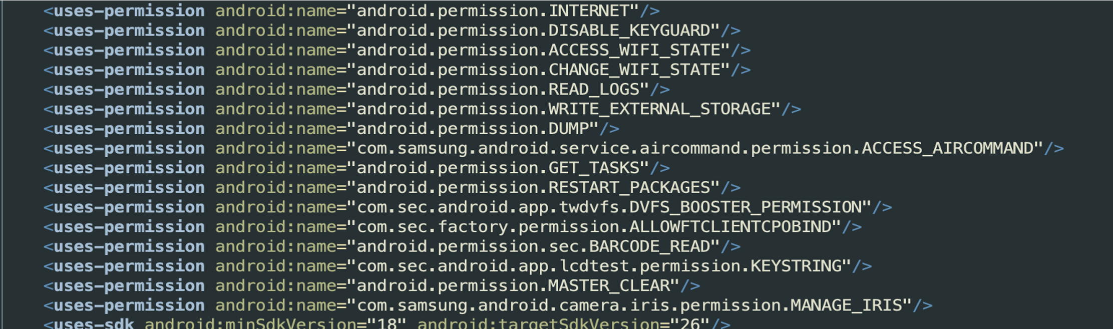
Android Manifest
+32%

Slide 8
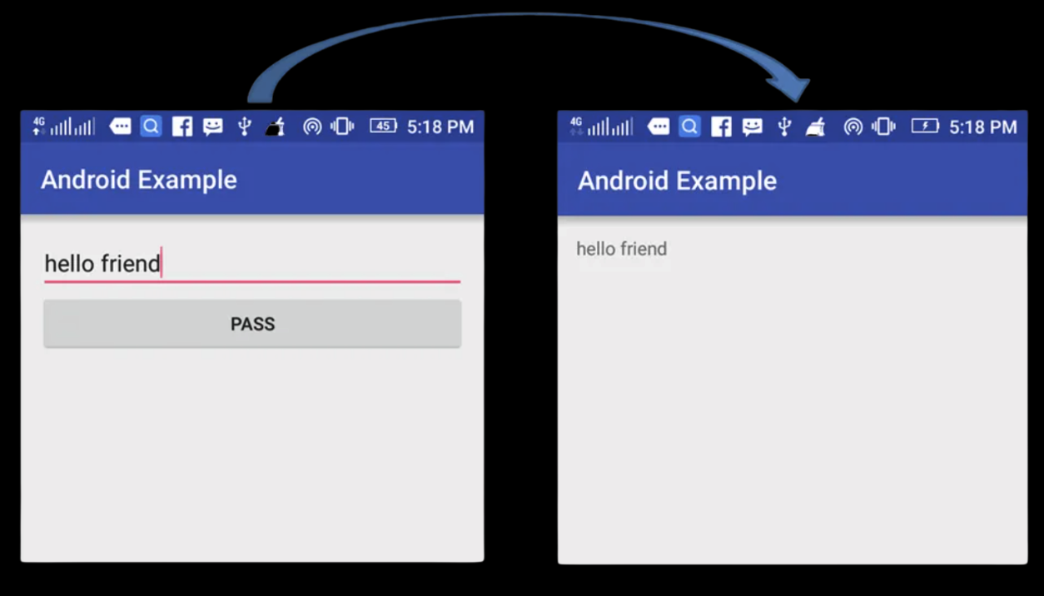
Android Activities
First Activity
Second Activity

Slide 9
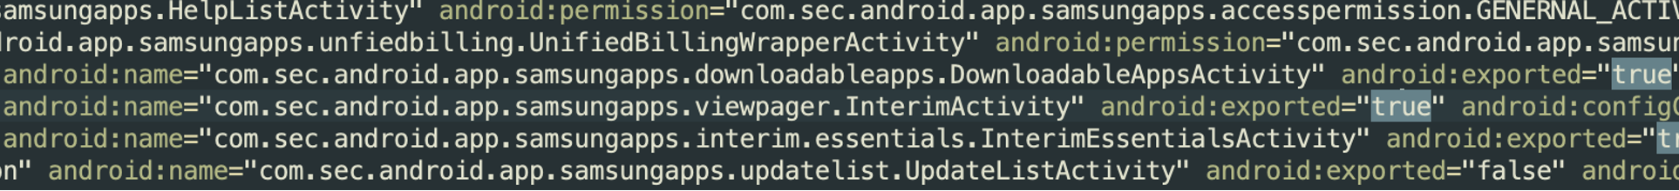
Android Activities
Activities can be exported or non-exported.
Activities that are exported can be called by third party applications
<activity android:name=".SomeActivity" android:exported="true"/>
Non exported activities can not be called by a third-party application
Unless chained with an Intent redirection bug

Slide 10

Android Intents
Intents are the most common type of IPC (Inter-Process Communication) used in Android devices.
Intents are high-level IPC that are sent as data containers and sent as Parcel objects to the system_process which then communicates with the Binder service.
Intents are commands with associated data that are delivered to components across processes
Notes:
Intests are the main way applications communicate to each other,
Intents can pass and read data if assigned the right flags and parameters to access the CRUD (Create/READ/Update/Delete) API’s
Intents carry data across applications to communicate to various parts and compontents of the applications.

Slide 11
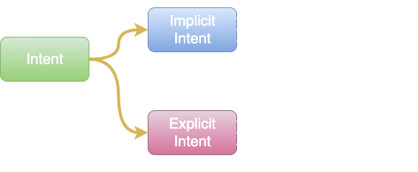
Android Intents
There are two types of Intents
Implicit Intents:
Intent intent = new Intent(Intent.ACTION_VIEW);
intent.setData(Uri.parse("https://google.com");
startActivity(intent);
Explicit Intents:
Intent intent = new Intent(getApplicationContext(); DemoActivity.class);
intent.putExtra("Value1", "Hello");
intent.putExtra("Value2", "Rux");
startActivity(intent);

Slide 12
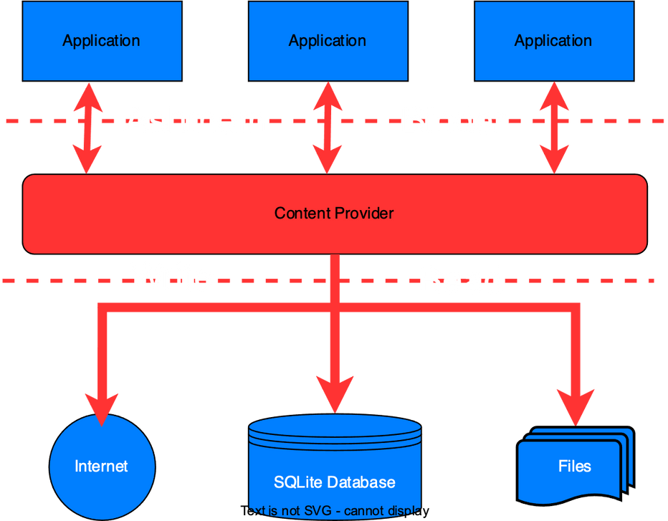
Content Providers
Content Providers encapsulates the data and provides defined mechanisms for data security.
Allows applications to access stored by itself, and other apps `
Content Providers and authorities are defined in the Android Manifest
Android restricted the access of the file:/// URI from SDK 18
Can be re-enabled by using vm.strictEnforce(False);

Slide 13
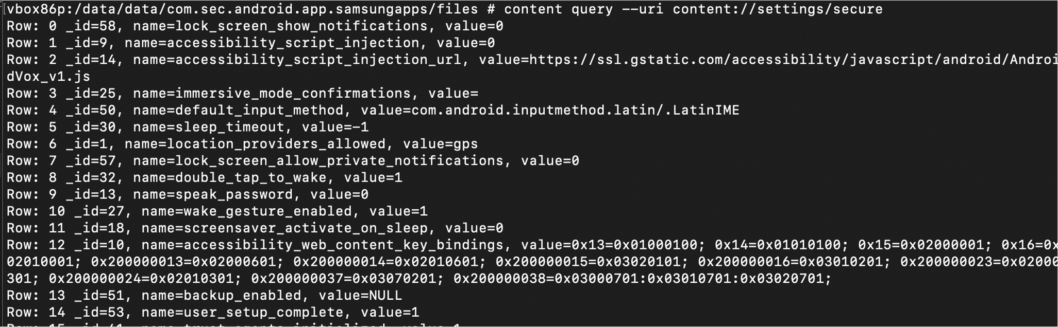
Content Providers
Content Providers can be queried using ADB (Android Debug Bridge)
<prefix>://<authority>/<data_type>/<id>

Slide 14
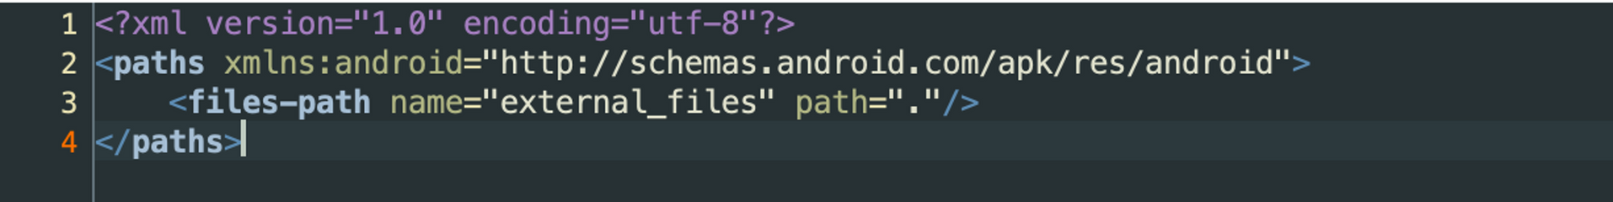
FileProvider
What is a FileProvider?
FileProvider is a sub-class of ContentProvider class
Controls application access app related files (secure sharing)
FileProvider is defined in the Android Manifest with an authority and the FileProvider key that its able to access such as
<provider android:name="androidx.core.content.FileProvider” android:authorities=”com.sec.android.app.samsungapps.fileProvider"/>
<meta-data android:name="android.support.FILE_PROVIDER_PATHS” android:resources=“@xml/file_paths"/>

Slide 15
FileProvider Keys
<root-path> - represents the root directory of the device
<files-path> - represents the files in applications internal file storage
<cache-path> - represents the files in cache subdirectory of the application storage
<external-path> - represents files in the root of the external storage area eg /sdcard
<external-files-path> - represents files in the root of your app's external storage area
<external-cache-path>- represents files in the root of your app's external cache area

Slide 16

Case Study
CVE-2021-25499
Intent Redirection in Galaxy Store

Slide 17
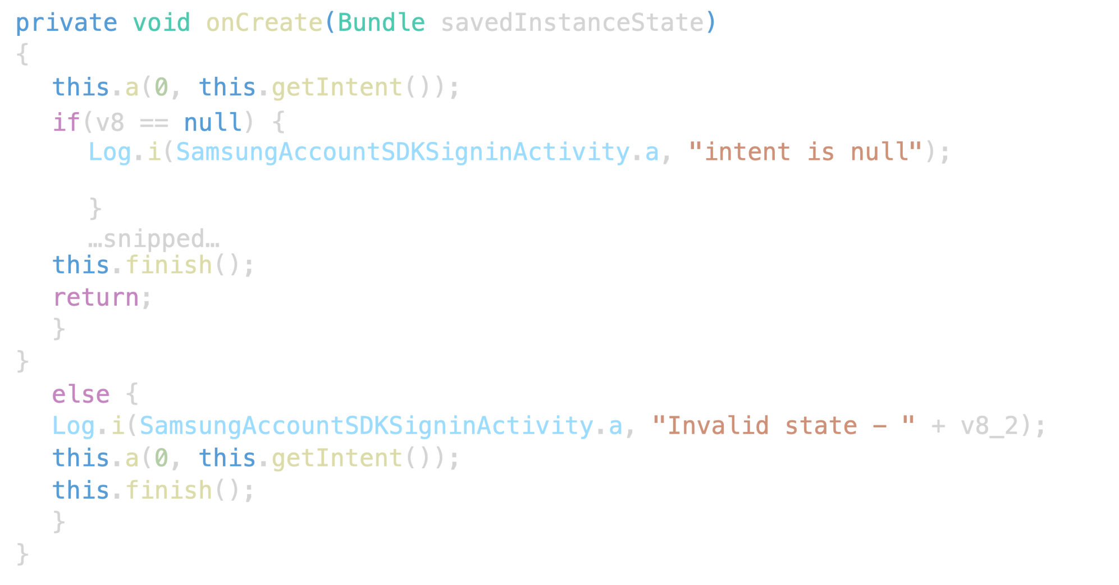
com.sec.android.app.samsungapps- SamsungAccountSDKSigninActivity

Slide 18
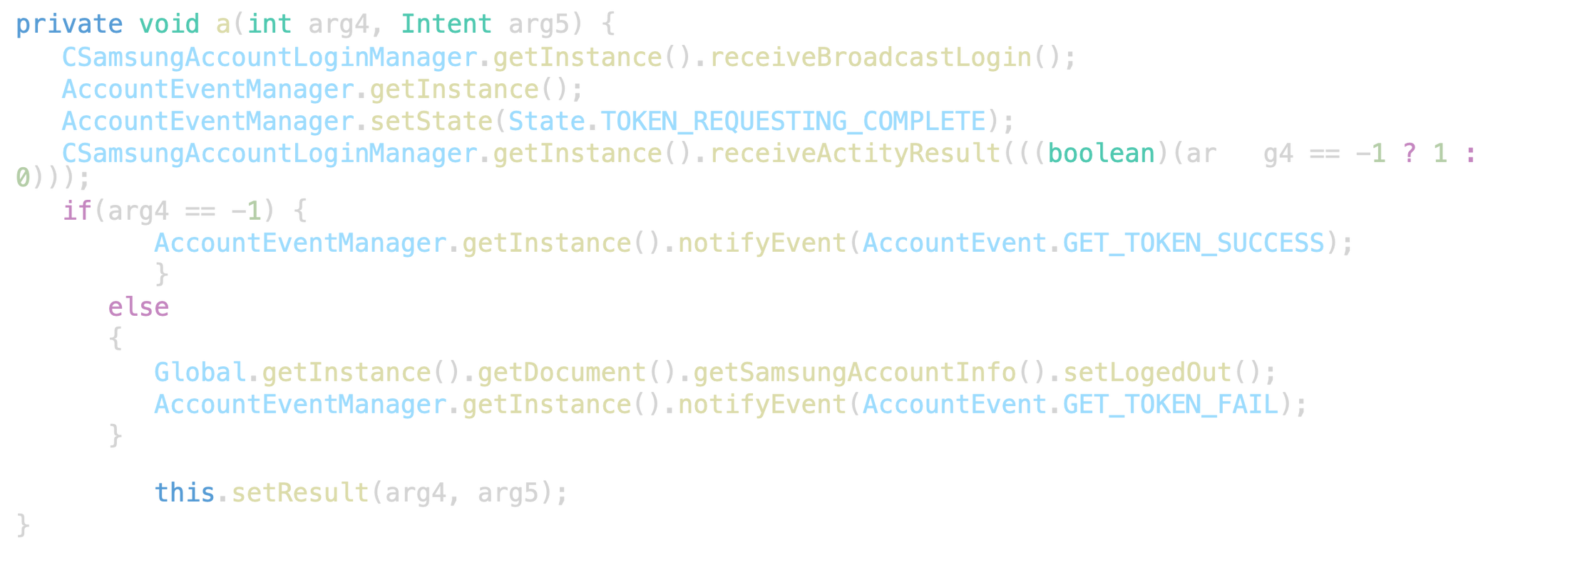
com.sec.android.app.samsungapps- SamsungAccountSDKSigninActivity - this.a(0, this.getIntent());

Slide 19
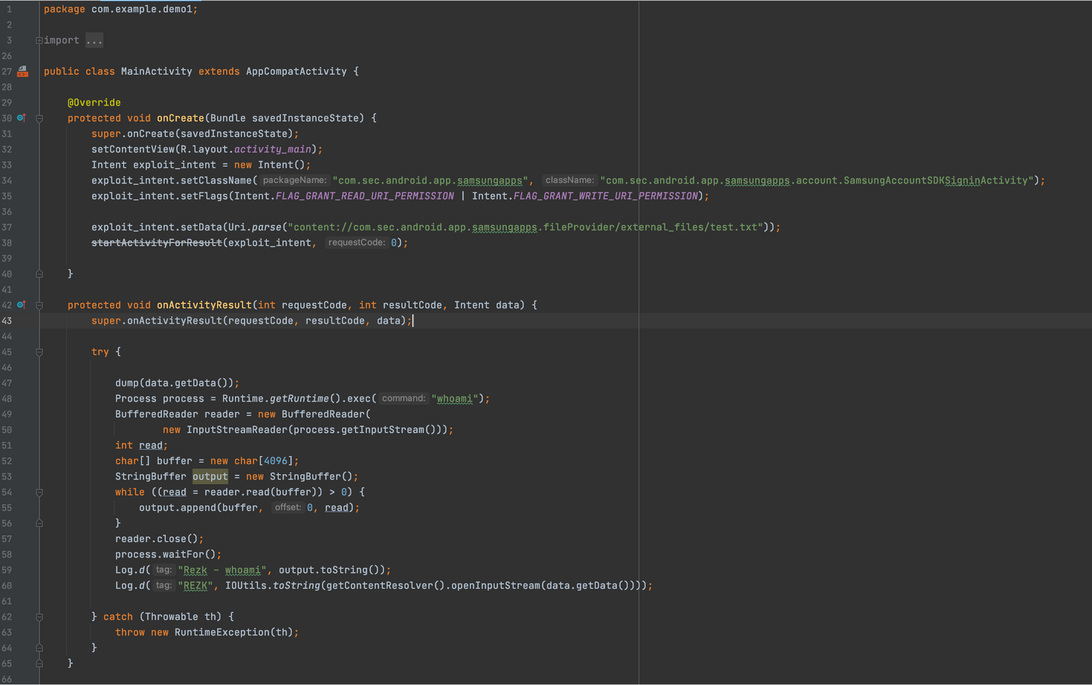

Slide 20
Notes:
DEMO

Slide 21
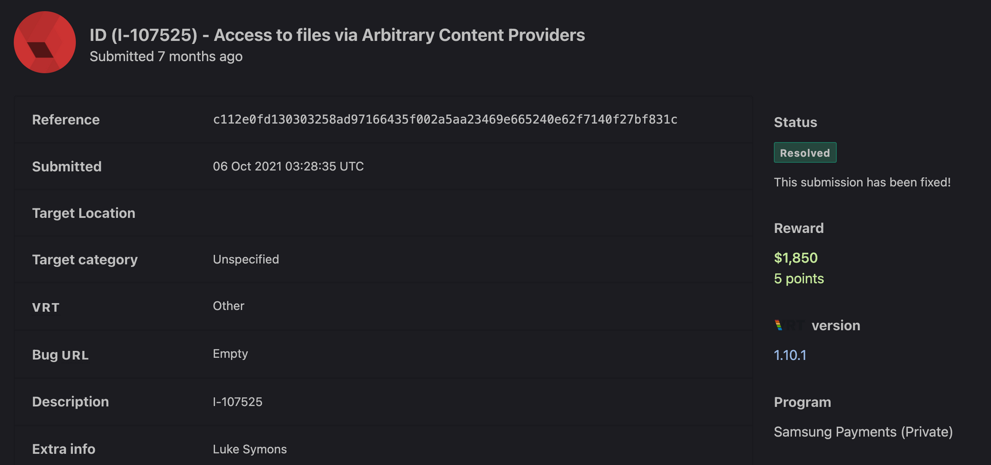

Slide 22
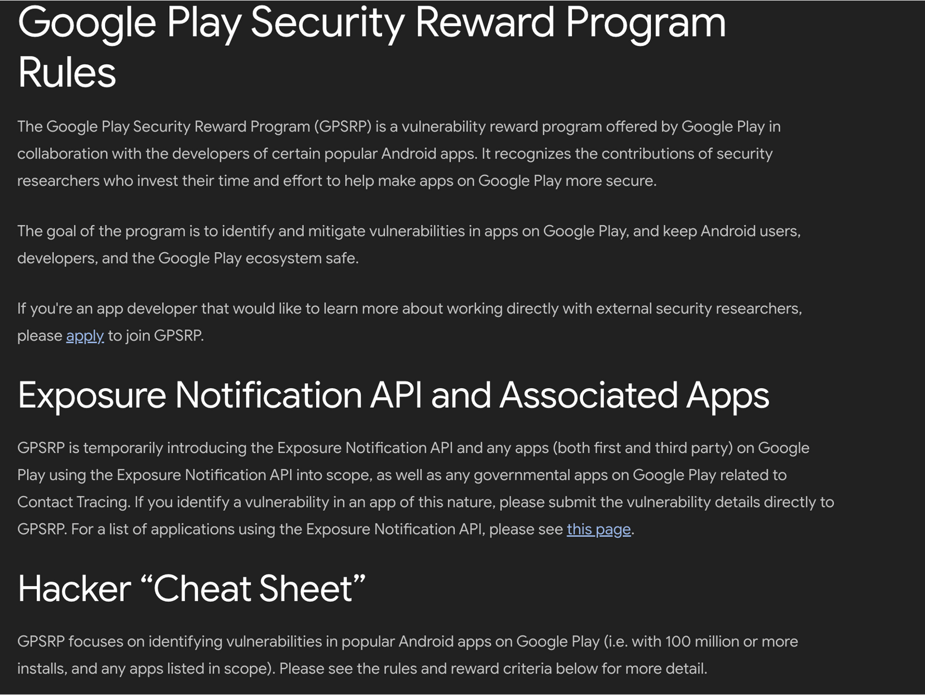

Slide 23
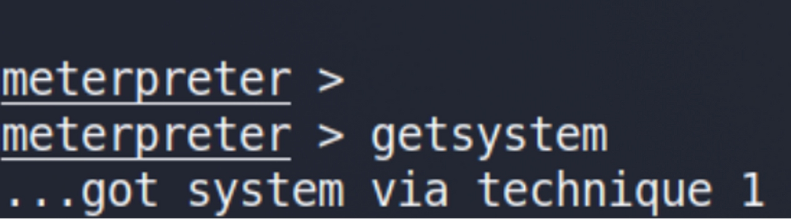


Improper Access Control To Gain System Permissions
CVE-2022-27838

Slide 24
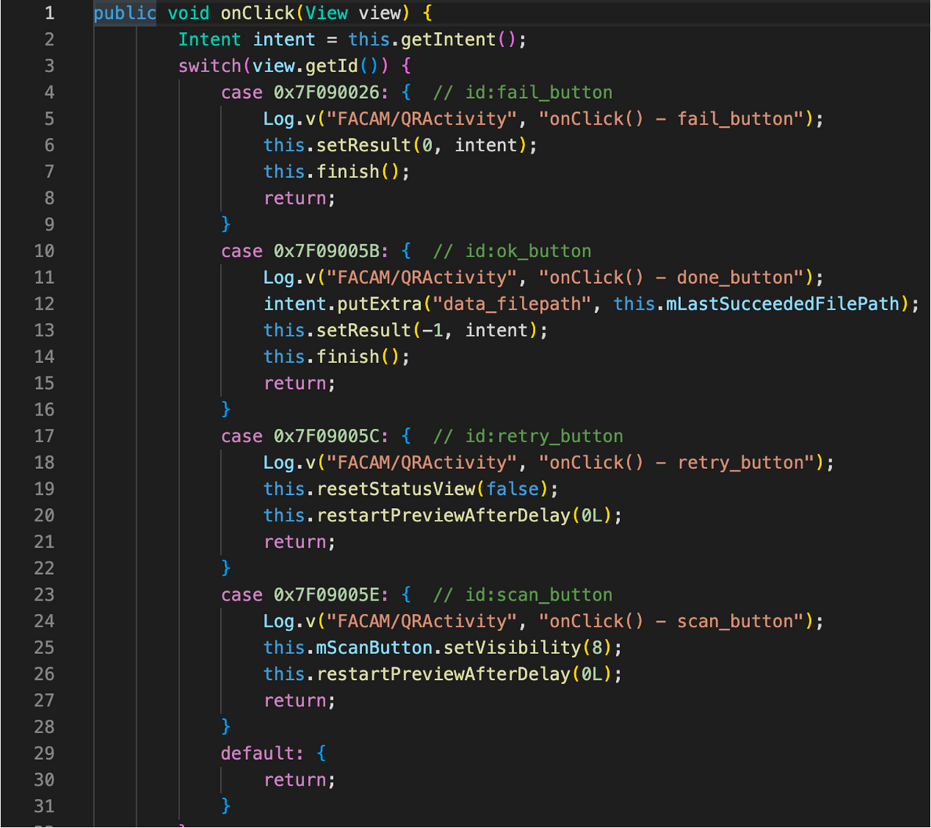
com.sec.factory.camera -com.sec.android.app.camaftest.CaptureActivity

Slide 25
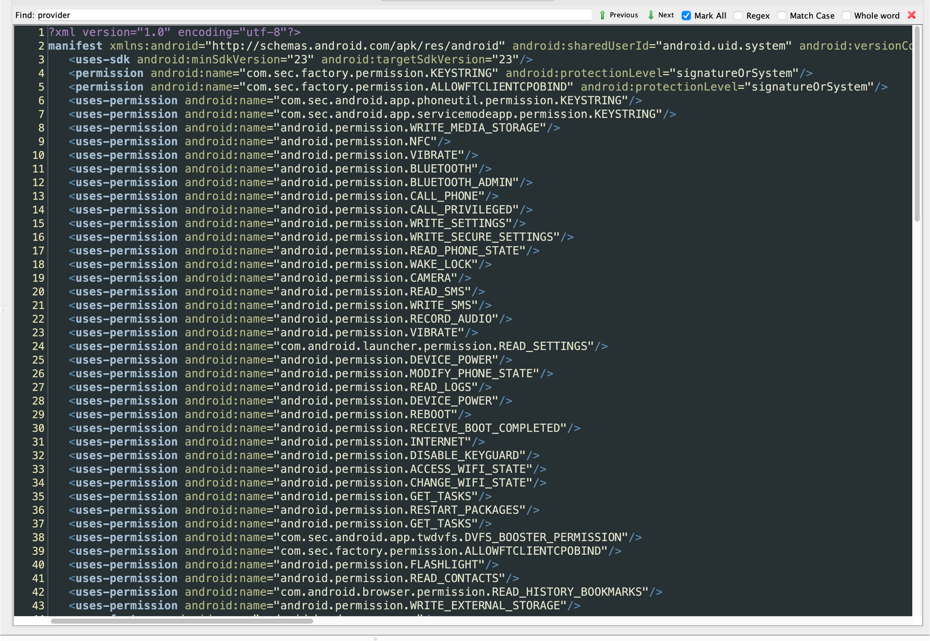

Slide 27
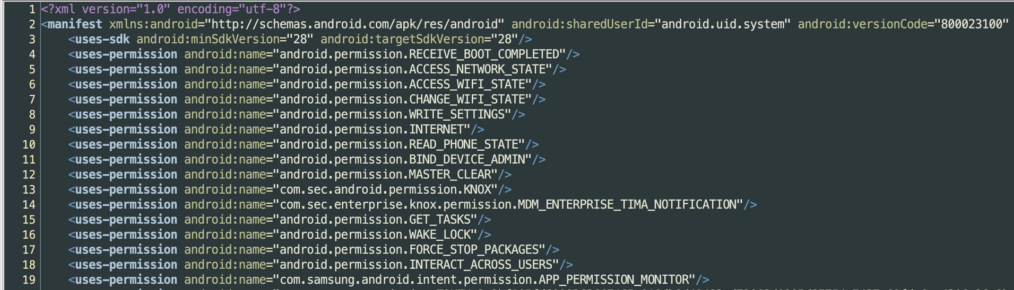
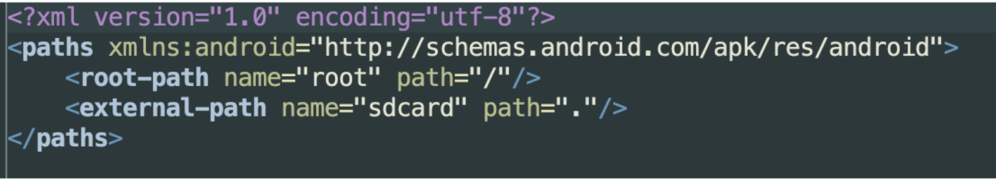
com.samsung.android.securitylogagent

Slide 29
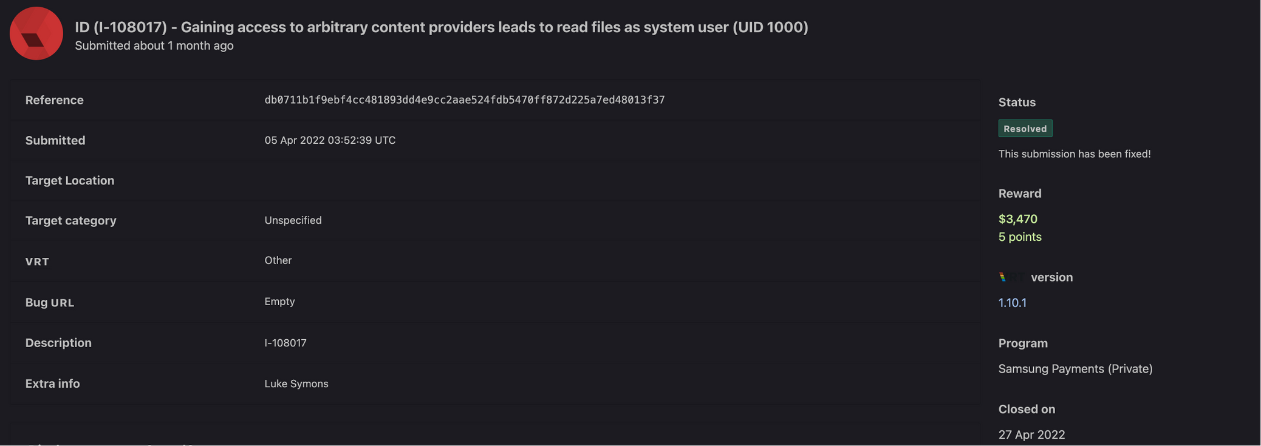

Slide 30
Some Tips for Finding Bugs
Review the Android Manifest:
Start with exported activities / services / providers / receivers
Take advantage of Decompiling tools:
JEB is paid and really good but;
JADX is pretty good as well and its free.
Pull all the APKs (including system apps) from the device as they also contain a lot of issues
SetResult($X, getIntent()); with an Intent you control is a win
GetLastPathSegment decodes %2F...%2F into /.../ leading to Path Traversal
Some rules for Android are now in graudit - https://github.com/wireghoul/graudit

Slide 31
Questions?
Notes:
Buy me beer.

Slide 32




K Bai.
Blog
https://x64.sh
Twitter
https://twitter.com/Rezk0n
Github
https://github.com/R3zk0n

